Slide 1
Brooke
Speaker
Date
Venue / Misc

Slide 2
A History of Brooke
Notes:
Over a million horses and mules sent overseas in WW1
Less than 60 000 returned to UK
Post 1918 thousands remained in Egypt, due to Australian quarantine rules not allowed to return home
Most sold off and end up doing heavy labour
New owners have little knowledge on how to care for equines
Dorothy Brooke arrives in Cairo in 1934
Raises funds and opens ‘ the Old War Horse Memorial Hospital
Brooke’s story began when one inspired animal lover , Dorothy Brooke, saw the suffering of animals that had been part of the Egypt Expeditionary Force in WW1. Due to Quarantine rules many thousand of these animals could not be repatriated. Dorothy set up a hospital to care for these animals. We have come along way since then.

Slide 3
So where do you think Brooke works now?

Slide 4
Notes:
Brooke works in 11 countries across Asia, Africa, the Middle East, Latin America and Australasia, through direct operations and partnerships with other charitable organisations. It also funds small projects in other countries through the Small Initiative Fund, which is now changing to the Innovation Fund.
100 million working equines are the engines that power the developing world, doing the hardest jobs under the toughest conditions to support the livelihoods of 600 million people. That’s 9% of the world’s population.

Slide 5
In your opinion…
What kind of problems affect working horses, donkeys and mules?
Think about hot, dusty work in poor countries where donkeys and horses often replace cars and lorries.

Slide 6
The Problem
Notes:
This is a donkey working in a coal mine in Pakistan. Here they work for up to 10 hours a day, thousands of metres down inside dusty and hot mines, carrying coal up and down, all day.
Working animals toil in the world’s toughest environments - from blistering heat to unbearable cold, sprawling urban slums and rubbish tips, chaotic city streets, remote villages and unforgiving terrain.
They transport building materials (everything from metal sheeting to bricks to huge pieces of wood), crops (often to and from market several times a day and without rest, shade or water), goods and people (including tourists in certain areas)
Picture: coalmine donkey, Pakistan

Slide 7
Notes:
They are often overloaded, sustain injuries that may not be properly treated and are vulnerable to disease
People living in marginalised communities use working horses, donkeys and mules to earn a living, so these animals are extremely important to these people. However, due to poverty or a lack of knowledge and veterinary services, their animals are often terribly overworked and poorly cared for.
These are the problems for them. Sick, injured and sometimes dying animals are still put to work because there’s no alternative for their desperate owners.
Picture: Donkey in Senegal

Slide 8
Notes:
Often carrying loads of over 50% of their body weight in extreme temperatures, over rough terrain and without water or shade. We don’t want to stop these animals being used to help with livelihoods but loads need to be managed ( 20% of body weight) and be secure and balanced with correctly fitted packs.
Picture: Indian brick kiln, where temperatures can rise to over 50°C/122°F. Workers are paid per whole brick delivered, so overload and discard broken bricks on route. Horses, donkeys and mules can trip and injury themselves, and also suffer from dehydration.

Slide 9
Notes:
We’re often asked why the owners don’t do more to help their animals. In Brooke’s experience few people are wilfully cruel and the owners are trying their hardest to care for their animals. It is lack of knowledge and lack of money that prevents many owners from giving the care their animals need. Brooke recognises that people live in poverty across the world, but that it is these people who can give the solution to many of the problems we have just seen….
Picture: Pakistan coal miner

Slide 10
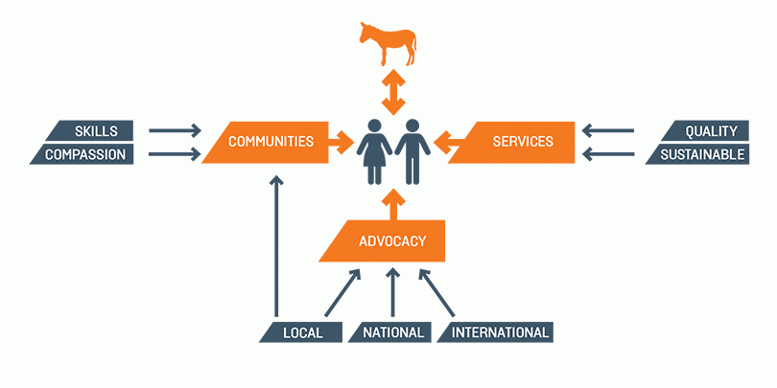
Our Solution
Notes:
Animals can’t change their welfare but people can! We have created a THEORY OF CHANGE – which is basically our plan or strategy to create the change and find a solution!
1. We work with communities to provide them with the skills and support to unlock both compassion for their animals and know how – what to do when their horse or donkey is unwell
2. We work to train local vets and animal health workers to improve their skills and get them to move away from some traditional ways of healing which can be harmful
3. Importantly we LINK the two groups together – so people know where and who to go to when their animal is sick
4. And finally! the bigger picture is working with national and international governments to ensure that laws are passed that protect working animals welfare now and into the future.
The following slides show how we work with a range of different people to ensure we have a holistic solution involving all:…..

Slide 11
Notes:
Brooke staff demonstrating welfare friendly practices to donkey owners in Afghanistan

Slide 12
Notes:
In the countries we work in, we work with staff teams that have experience and expertise in veterinary skills but importantly are trainers who can train local vets and animal health workers to provide those services when we’re not there; this is an example of Farriery training in India – healthy hooves make a real difference to a healthy animal- preventing injuries such as lameness
To help us make sure we are reaching the working animals in most need, staff in all our country programmes use the same approach to identifying animals’ welfare problems. The approach was developed in partnership with Bristol University Veterinary School.
We must understand the local and specific causes of the welfare problems affecting animals and their owners rather than making assumptions or adopting a ‘one size fits all’ approach. Doing research to gain this understanding helps us to give the most effective advice to animal owners and local people, so it’s essential to Brooke’s work.
Brooke Country Programme teams who live in country are the closest to both the animals and the people who own or use them, so their experience is vital for answering those important research questions.
Research is also vital to support our conversations with governments and policy makers (our Advocacy work), to show them that the fundamental needs of these working animals are based on facts, rather than simply Brooke’s opinions.
The Five Freedoms, created by the UK Farm Animal Welfare Council are used by Brooke to define what every animal should have:
• Freedom from hunger and thirst – having access to fresh water and a diet to maintain full health and energy.
• Freedom from discomfort – providing appropriate living and working conditions including shelter and a comfortable resting area.
• Freedom from pain, injury and disease – ideally prevention, but if not, a fast diagnosis and treatment.
• Freedom to express normal behaviour – providing sufficient space and proper facilities so that animals can groom and play with each other, and relax.
• Freedom from fear and distress – ensuring conditions and treatment which avoid mental suffering

Slide 13
Notes:
As simple as a shelter for shade
Photo: Dewa Equine Fair, India

Slide 14
Notes:
In Kenya we support schools in running Mtunze Punda ("donkey care") clubs, which teach children how to look after donkeys and establish life-long, welfare-friendly behaviour towards them. The clubs have a range of activities such as poetry, games, music and theatre, as well as teaching children donkey husbandry practices. Our aim is for these children to promote donkey welfare within their own families and communities, leading to healthier and happier animals.

Slide 15
Notes:
School children in Senegal learning how to take care of their animals

Slide 16
See the Difference
Notes:
To sum up – the Brooke is working to make sure that working animals are healthy, happy and able to help support their owners family.
Simple and quick changes like offering a horse or donkey water two or three times more over the course of a day, or making sure their hooves are clean, can change their lives.
So, as you can see, with the help of our supporters, we can and do make a difference to the lives of both the animals and the people. But here’s the thing – Brooke are now reaching almost 2 million animals each year, but as I mentioned, there are 100 million in the world, so there are still millions more that might need our help.

Slide 17
Make a Difference
Notes:
[The Ask – for schools:]
Spread the word –Would you like to help spread the word about Brooke’s vital work? Giving talks about Brooke in your local area is a great way to help raise awareness and encourage others to support its work. But please also just tell your friends and contacts, and if your vets, doctors or local library would be happy to display some newsletters and posters please contact the Brooke and we can provide these.
If you’d like to raise money for us, you can take on a challenge - from running events to skydives, horse rides to dog sledding across the Arctic, there are many ways to get involved in once-in-a-lifetime experiences whilst raising vital funds for the Brooke’s work.
You can also organise your own event as a group - holding your own event in aid of Brooke is a great way to raise awareness, raise funds and have fun! Whether you fancy holding a cake bake, quiz night, fashion show, raffle or a collection, Brooke can send you fundraising materials and provide advice to make your event a huge success.
Contact community@thebrooke.org

Slide 18
Thank you for listening!
More information: thebrooke.org
Notes:
Say there is info available or leave time for questions?
Optional: short film https://www.youtube.com/watch?v=mw075PnTU24 Warning: contains images some may find distressing.

